Slide 1

Unlocking Customer Insights: A Transactional Data Analysis
This presentation delves into customer shopping behavior, leveraging transactional data to unearth actionable insights for strategic business decisions.

Slide 2

Project Overview: Illuminating Shopping Patterns
Data-Driven Insights
Strategic Goal
Analyzed 3,900 customer purchases across diverse product categories.
Uncover spending patterns, customer segments, and product preferences to inform business strategy.
Subscription Behavior
Examined how subscription status influences purchase frequency and value.

Slide 3

Dataset at a Glance: The Foundation of Our Analysis
Rows
3,900 customer transactions
Columns
18 detailed features
Key Demographics
Age, Gender, Location, Subscription Status
Purchase Details
Item, Category, Amount, Season, Size, Color
Shopping Behavior
Discount, Promo Code, Previous Purchases, Frequency, Review Rating, Shipping Type
A rich dataset provides a comprehensive view of customer interactions.

Slide 4
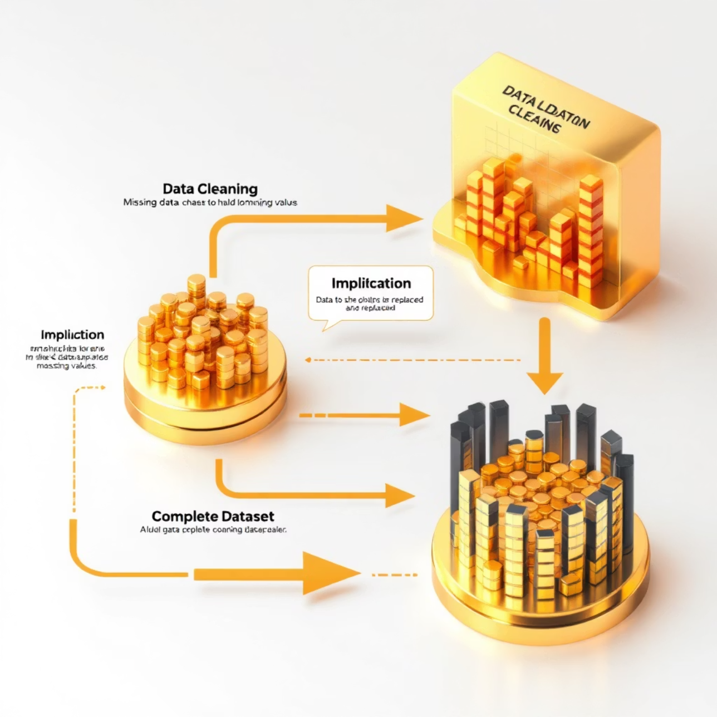

Addressing Data Challenges: Handling Missing Values
Even robust datasets can have gaps. Our analysis meticulously addressed missing data to ensure accuracy.
Missing Data
Imputation Strategy
37 values in the 'Review Rating' column identified.
Missing review ratings were imputed using the median rating for each product category.
Ensuring Integrity
This method maintains data integrity while preserving nuanced category-specific sentiments.

Slide 5

Python's Role: Exploratory Data Analysis & Preparation
Data Loading
1
Seamlessly imported the dataset using the pandas library.
Initial Exploration
2
Utilized df.info() and .describe() for structural and statistical overview.
Missing Data Handling
3
Identified and imputed null values in 'Review Rating' with category medians.
Column Standardization
4
Renamed columns to snake_case for enhanced readability and maintainability.

Slide 6

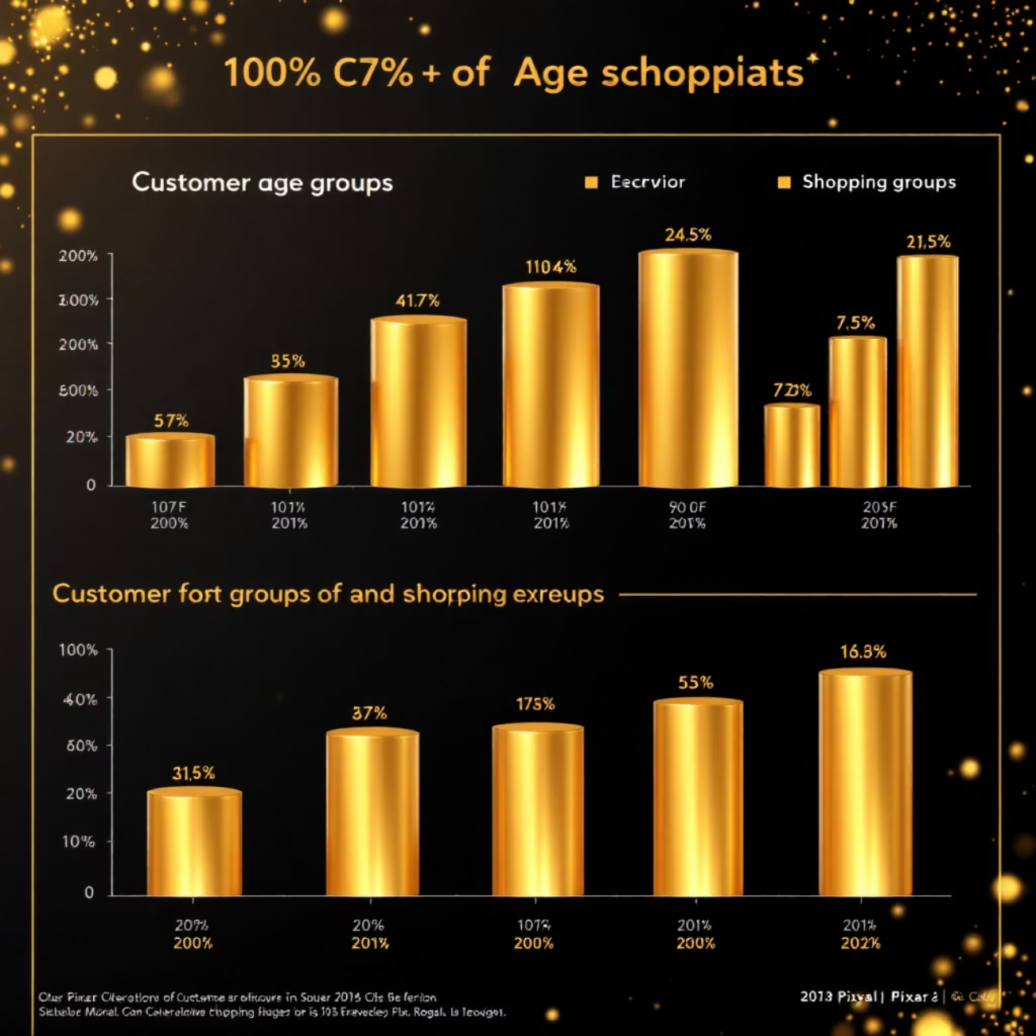
Feature Engineering: Enriching Our Data
1
2
Age Group Segmentation
Purchase Frequency
Developed a purchase_frequency_days column to quantify buying habits.
Created an age_group column by categorizing customer ages into meaningful bins.
3
Enhanced Analysis
These new features provide deeper insights into customer demographics and behavior.

Slide 7







Data Consistency & Optimization
Ensuring the integrity and efficiency of our dataset was crucial for accurate analysis.
Redundancy Check
Streamlined Data
Optimized Structure
Verified if 'discount_applied' and 'promo_code_used' conveyed similar information.
Removed the 'promo_code_used' column to eliminate redundancy and simplify the dataset.
This step improved data quality and prepared it for robust analysis.

Slide 8

Database Integration: From Python to PostgreSQL
The cleaned and prepared data was seamlessly transitioned for advanced SQL querying.
01
02
Python Connection
Data Loading
Established a secure connection between our Python environment and a PostgreSQL database.
The processed DataFrame was efficiently loaded into the PostgreSQL database.
03
SQL Readiness
This integration enables powerful SQL-based analytical operations.

Slide 9




Next Steps: Deep Dive into SQL Analysis
With the data meticulously prepared and integrated, the next phase focuses on extracting granular insights.
Segmentation
Identify distinct customer groups based on behavior and demographics.
Product Performance
Analyze popular products, categories, and their impact on revenue.
Subscription Impact
Quantify the value and behavior of subscribed customers.
Actionable Insights
Translate findings into strategic recommendations for marketing and product development.

Slide 10

Turning Data into Decisions
Our comprehensive analysis of customer shopping behavior provides the foundational intelligence needed to drive impactful business growth and foster deeper customer relationships.
Thank You!

